Slide 1
Code walkthrough
Project: BayernID Automation Testing Tool

Slide 2
Technology Stack
Java 8
Selenium IDE
TestNG
POI API
Selenium WebDriver

Slide 3
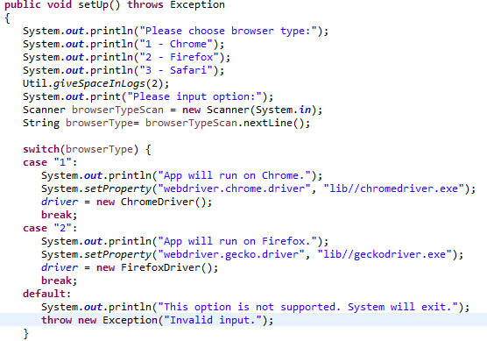
Starting Point
Program will start from BayernPortalMain class which is used to drive the process. Below code presents the choice of the browser to User:

Slide 4
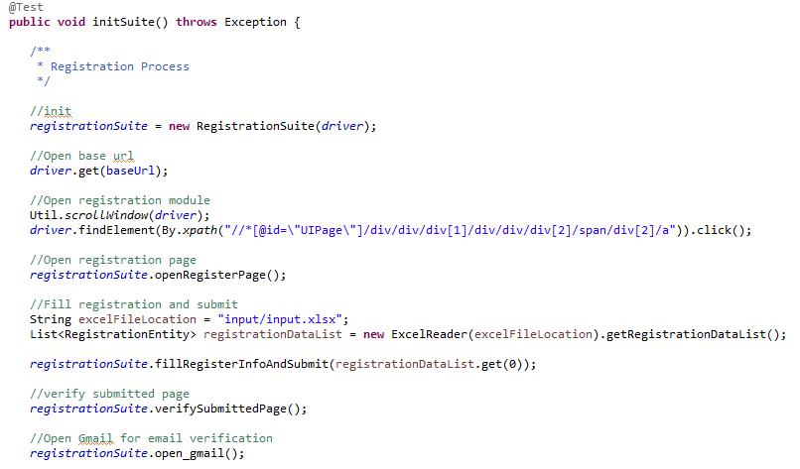
Algorithm for complete registration process
To complete the registration process and login process, Main class has the steps to proceed like below:

Slide 5
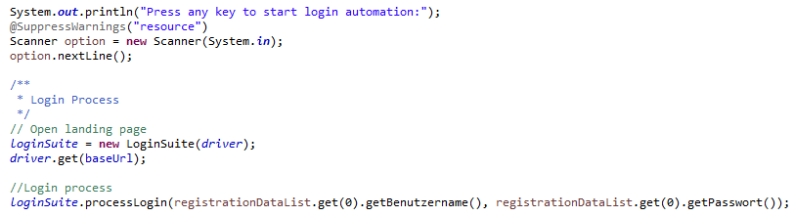
Algorithm for complete login process
To complete the login process and login process, Main class has the steps to proceed like below:

Slide 6
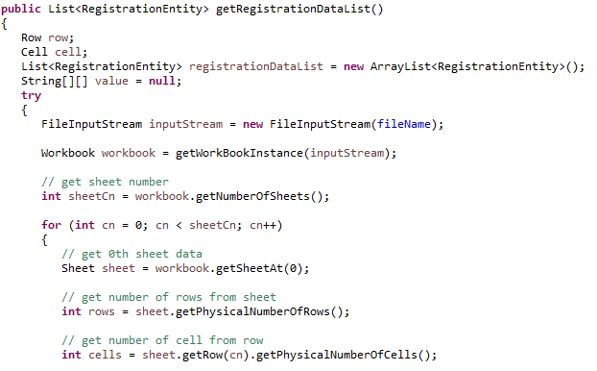
Data Store
For registration process, registration data is being fetched from Excel file in input/input.xlsx location. And by using POI API, data from excel is converted to list of RegistrationEntity java POJO class.

Slide 7
Thank you

